Slide 1
Abu Huraira Student OF BS AI Group A
Topic name: Output devices

Slide 2
Definition to output:
Output refers to the result or product of the process, system, or device.
It is the information, data, or material generated or produced by a computer, machine or other device, weather it is in physical form, or electrical form.
For example: printed documents, displayed images, etc.

Slide 3
Output devices:
Output devices are hardware components that receive data from computer or other devices and display, print, or produce the output in various form.
Output devices are further divided in many types.
Some of them are mentioned here;
Visual output devices;
Visual output devices display information in visual form, enabling users to view text images videos, and graphics.

Slide 4
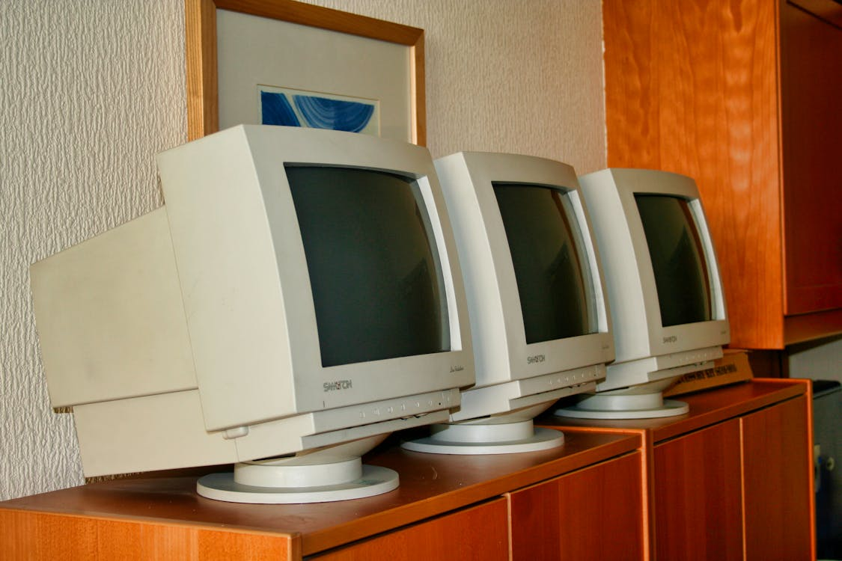
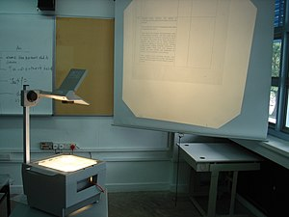
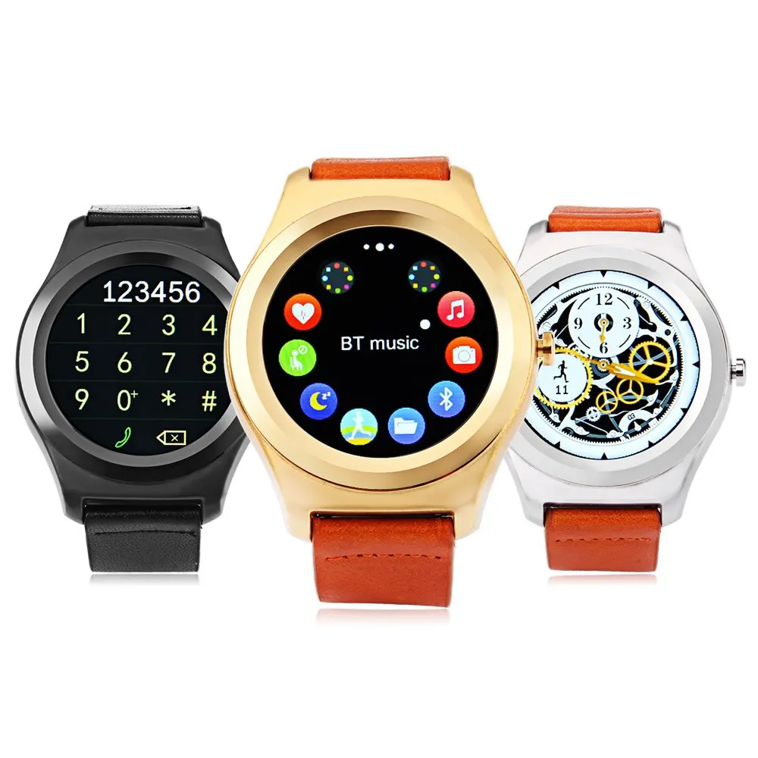
Example:
Monitors, projectors, smartwatches etc.

Slide 5
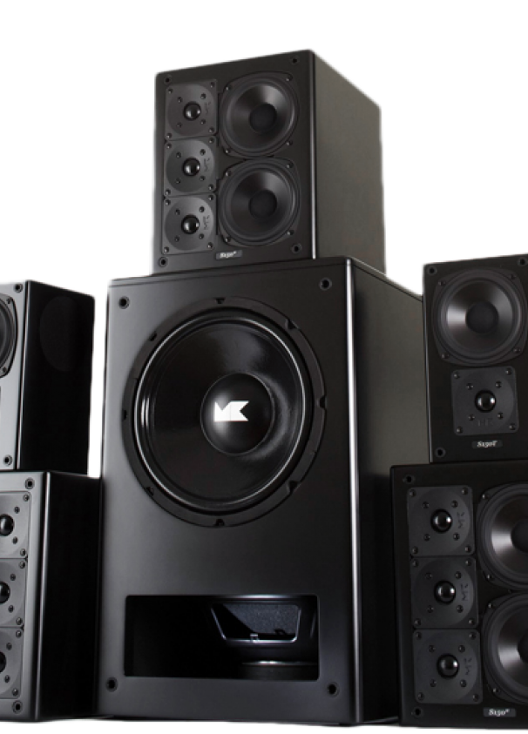
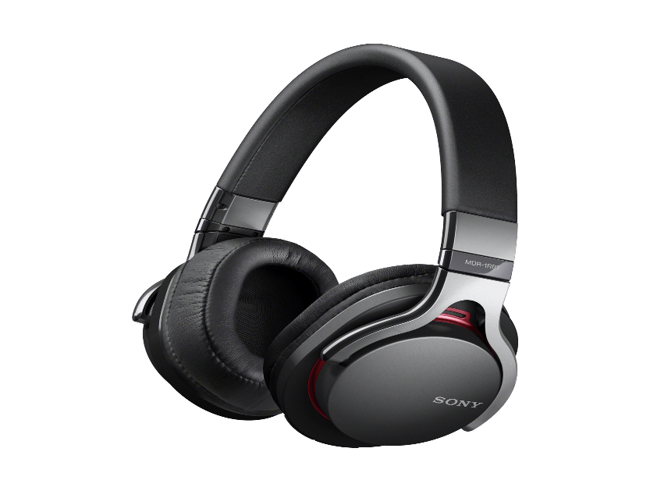
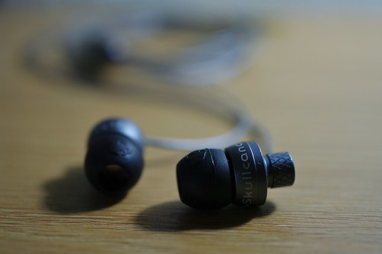
Audio output devices: Audio output devices produce sound, enabling user to hear music, voice, and other audio signals. Types of audio output devices: Speakers Headphones (wired, wireless, noice cancelling. Ear buds etc.

Slide 6
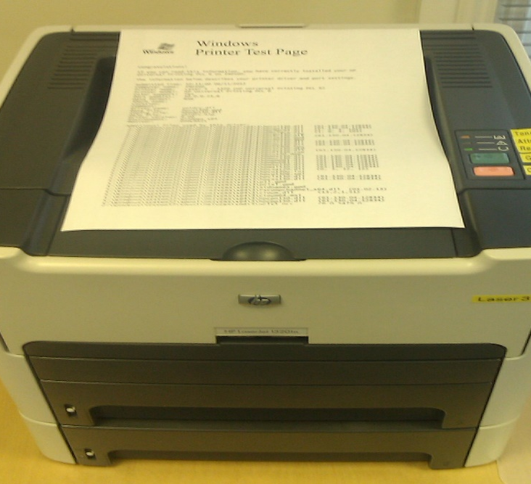
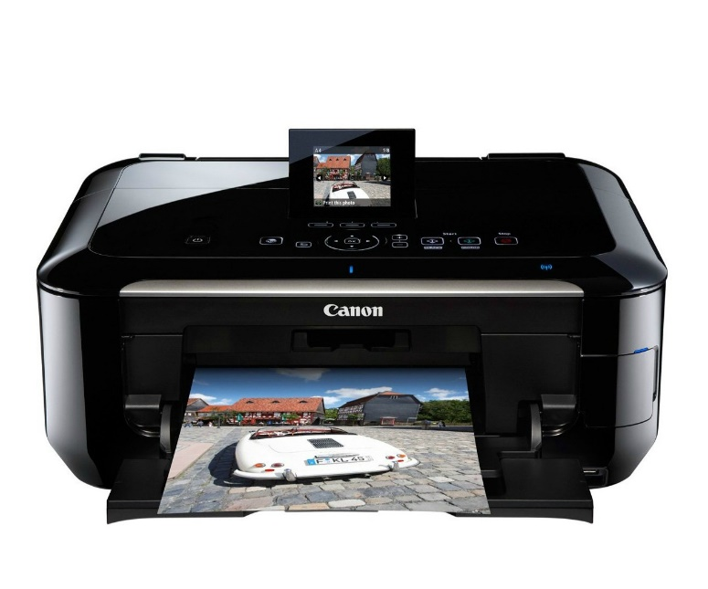
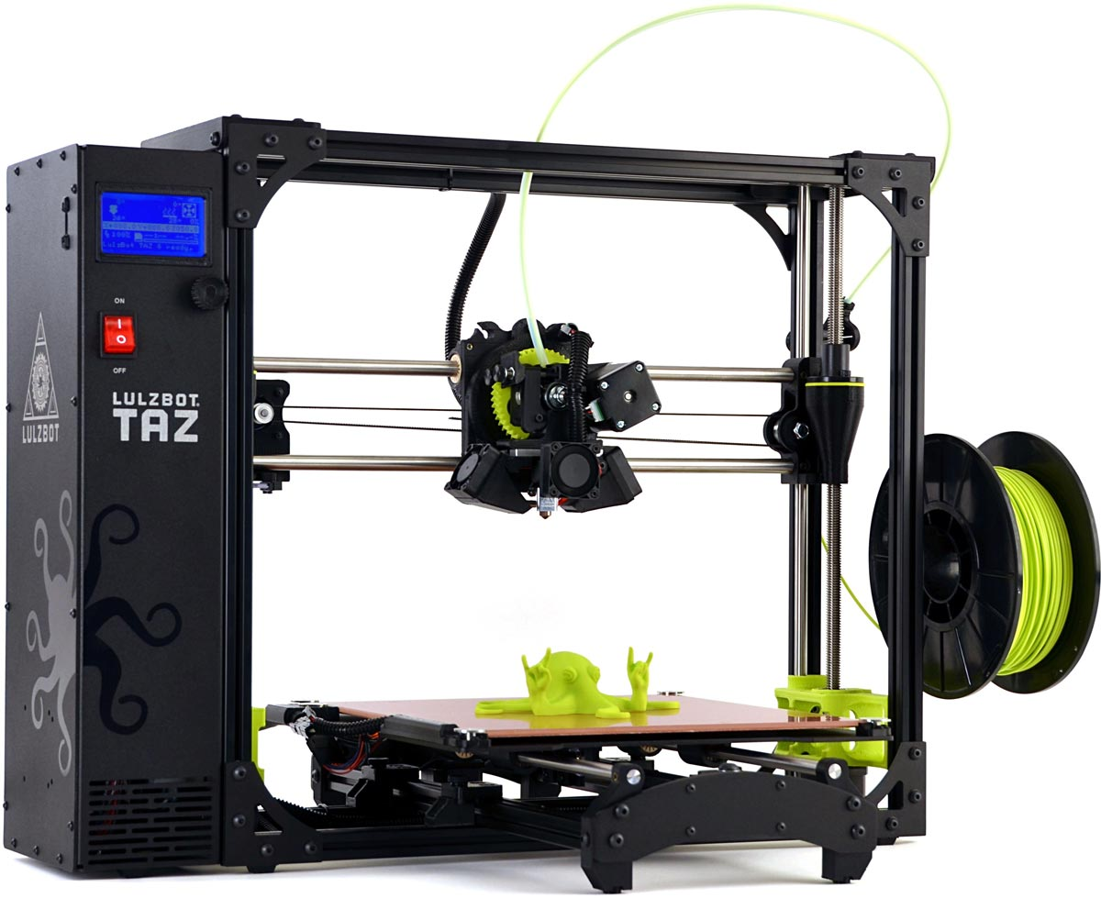
Print output devices: Print output devices produces physical copies of digital data, such as text, documents, images, and graphics. Types of print output devices: Inkjet printers laser printers 3D Printers.

Slide 7
Tactile output devices : Tactile output devices provide physical feedback or sensations to users, enhancing interaction with technology. Here are some common types. Vibration motors uses in smartphones and game controllers to create tactile feedback during interactions. Game controller rumbles : controller for video games that shake or vibrate during gameplay for a more immersive experience.

Slide 8
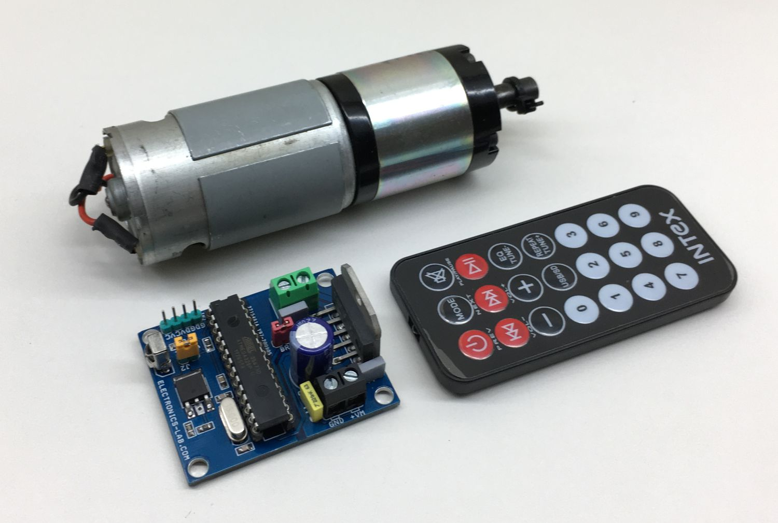
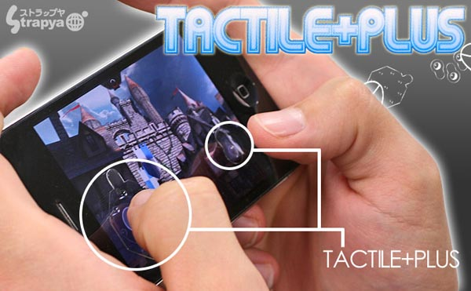
Thank you.

